Slide 1
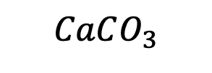
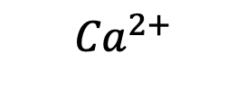
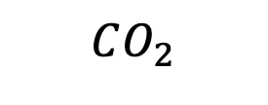
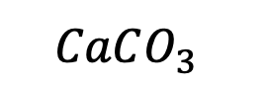
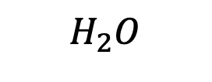
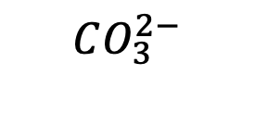
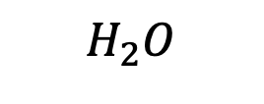
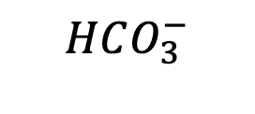

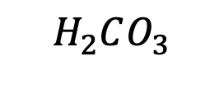
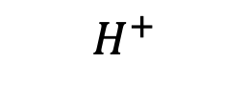
Week 8 – Ocean acidification
Air
$$CO_{2}$$
Battery acid
$$H_{2}O$$
$$H_{2}O$$
Oceans
$H_{2}CO_{3}$
$$H^{+}$$
$$H^{+}$$
$$HCO_{3}^{−}$$
$${Ca}^{2+}$$
$$CO_{3}^{2−}$$
Sea floor
$$CaCO_{3}$$
$$CaCO_{3}^{}$$
Sodium hydroxide (active ingredient in DranoTM)

Slide 2
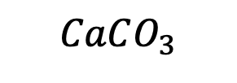
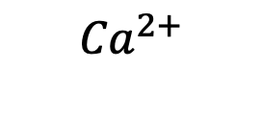
The kind of question I might ask
When calcium carbonate (chalk) at the sea floor dissolves in the water …
it amplifies ocean acidification
it counteracts ocean acidification
it has no effect on the ocean’s acidity
In nature, this process takes place …
quickly on a human time scale (~seconds)
slowly on a human time scale (centuries or more)
Air
$$CO_{2}$$
$$H_{2}O$$
$$H_{2}O$$
Oceans
$H_{2}CO_{3}$
$$H^{+}$$
$$H^{+}$$
$$HCO_{3}^{−}$$
$${Ca}^{2+}$$
$$CO_{3}^{2−}$$
Sea floor
$$CaCO_{3}$$
$$CaCO_{3}^{}$$

Slide 3
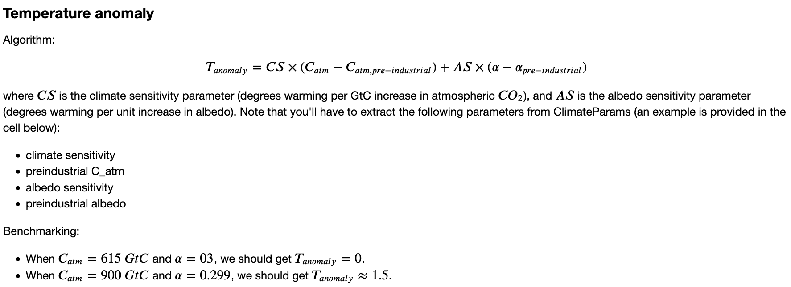
Week 9: DiagnosticFunctions, we worked on making Python functions

Slide 4
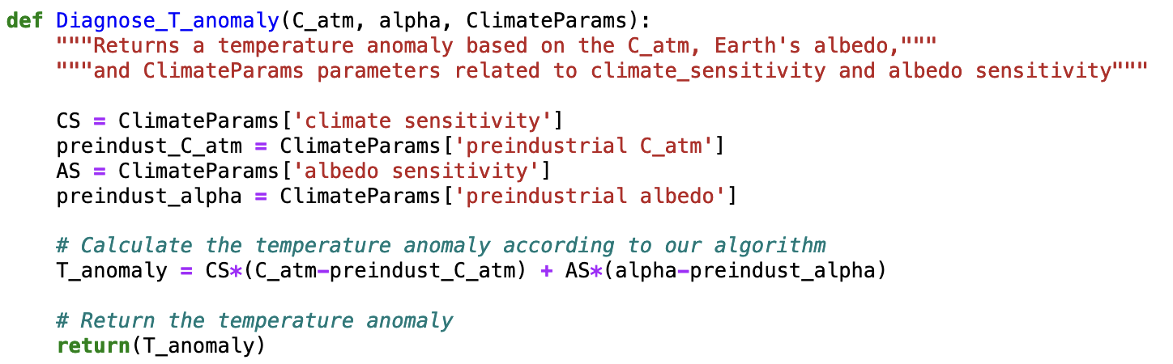
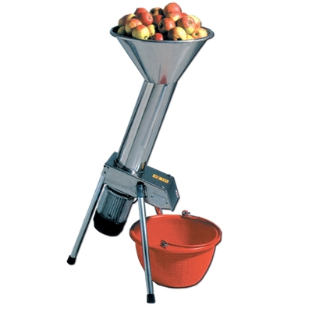
The kind of question I might ask
In the code below, which corresponds to the whole apples? To the grinder? To the ground up apples?

Slide 5
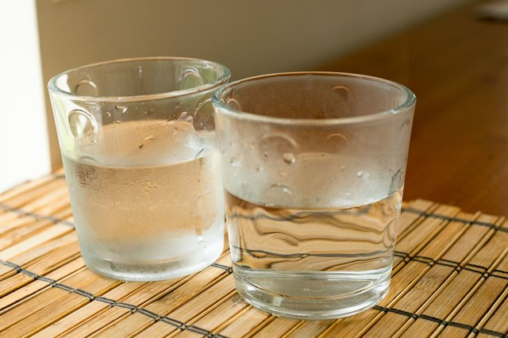
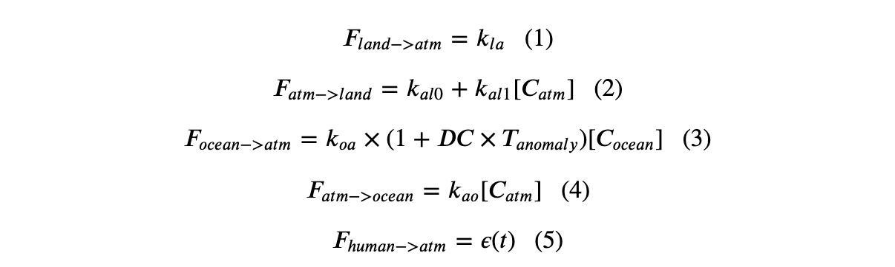
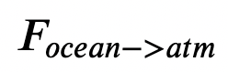
The kind of question I might ask
What’s new in Cambio 2.0? (Mathematically, physically)
Cold ocean
Warm ocean

Slide 6
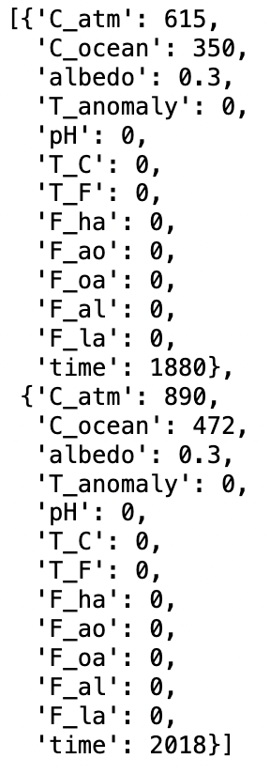
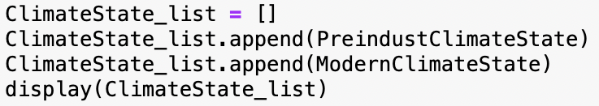

The kind of question I might ask
This code would produce which output?
A
B
C
D

Slide 7
The kind of question I might ask
CS = …
The Blue line shows the climate sensitivity as the climate has responded to … __________ forcing over the last _________ years.
The orange line shows the climate sensitivity as the climate has responded to … __________ forcing over the last _________ years.
We’d calculate CS by …

Slide 8
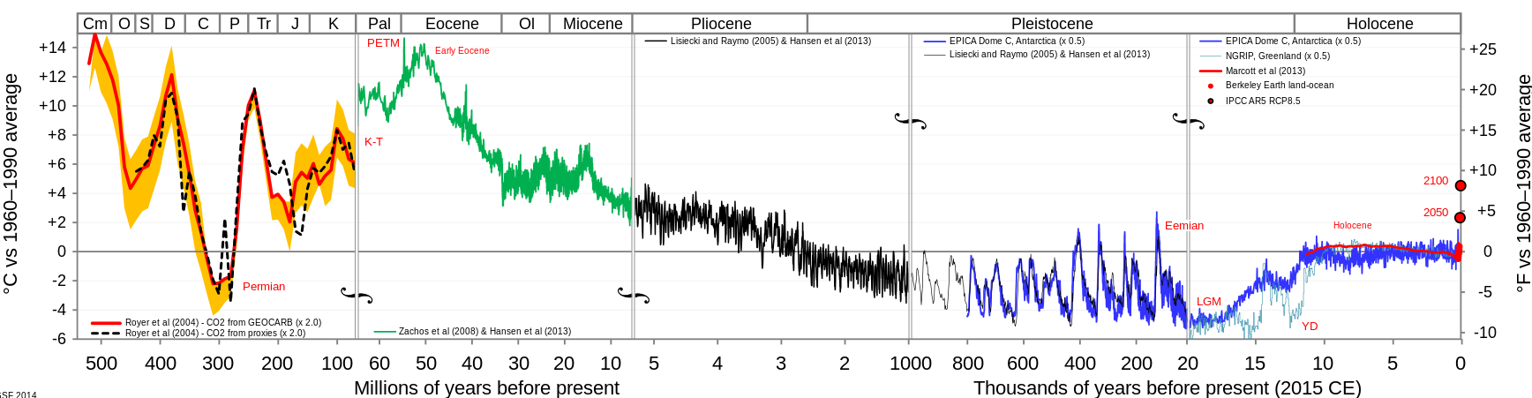
The kind of question I might ask
The drop in temperature starting 50 million years ago is due to …
The destruction of “snowball Earth”
Collision of the India plate with the Asia plate
Milankovitch wobbling
Anthropogenic CO₂ release

Slide 9
The kind of question I might ask
The timing of the ups and downs in the last million years is due to …
The destruction of “snowball Earth”
Collision of the India plate with the Asia plate
Milankovitch wobbling
Anthropogenic CO₂ release

Slide 10
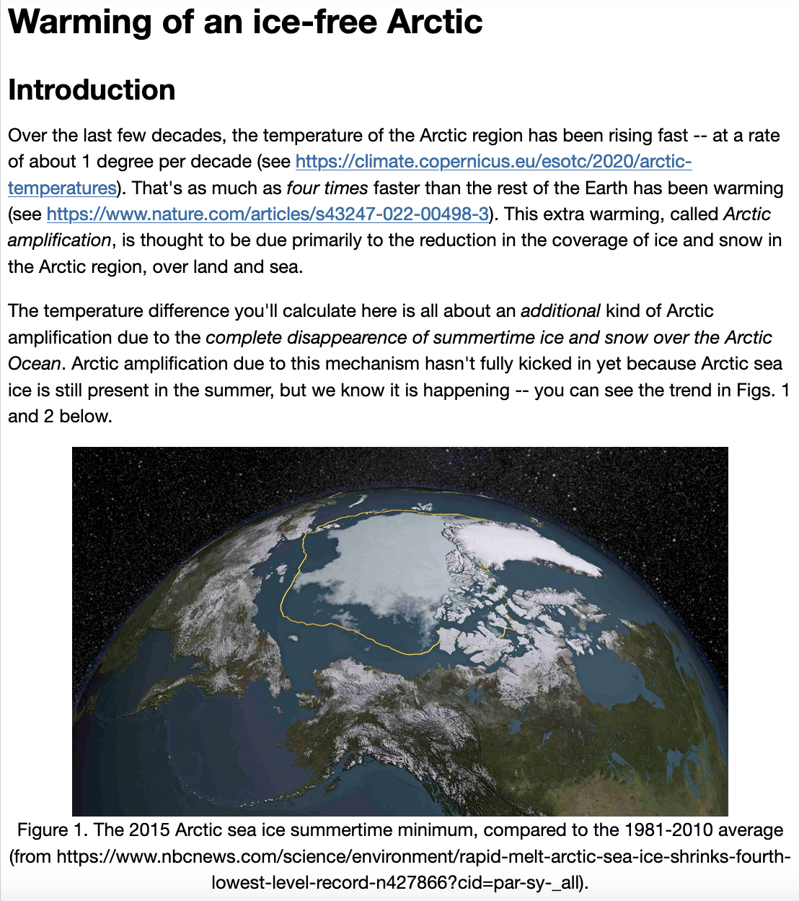
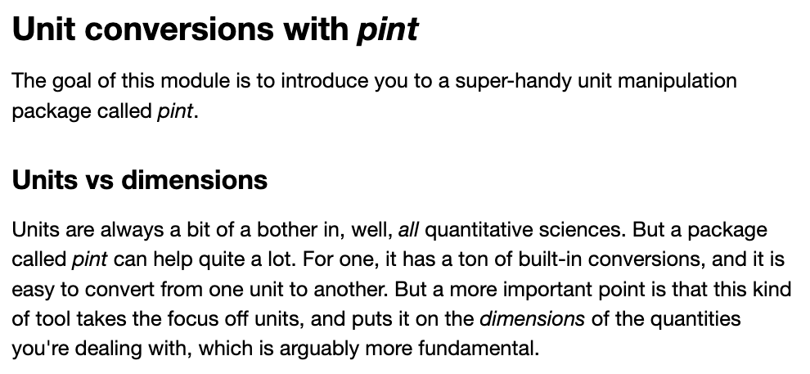
Week 10: Polar amplification

Slide 11
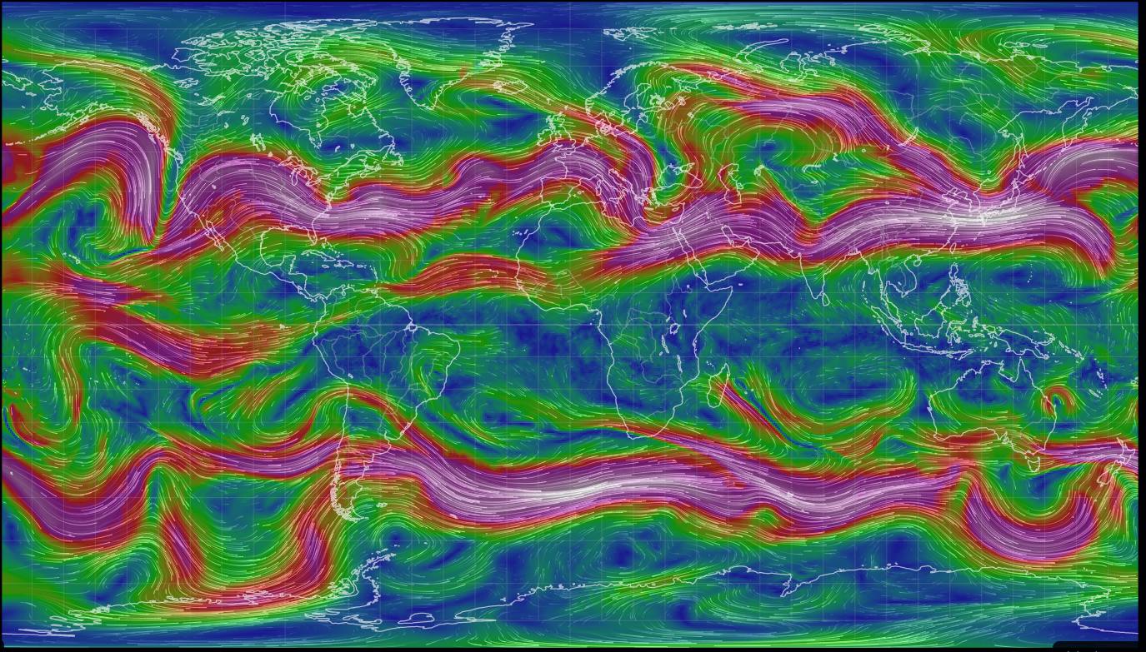
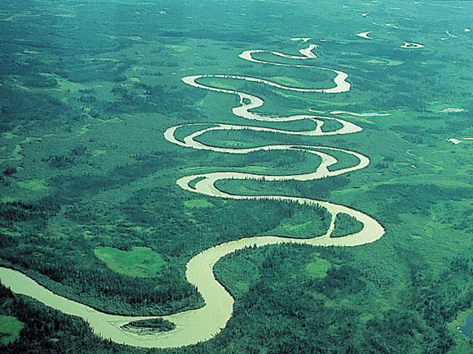
The kind of question I might ask
Cold Arctic air
Warm mid-latitude air
Cold Antarctic air

Slide 12
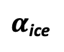

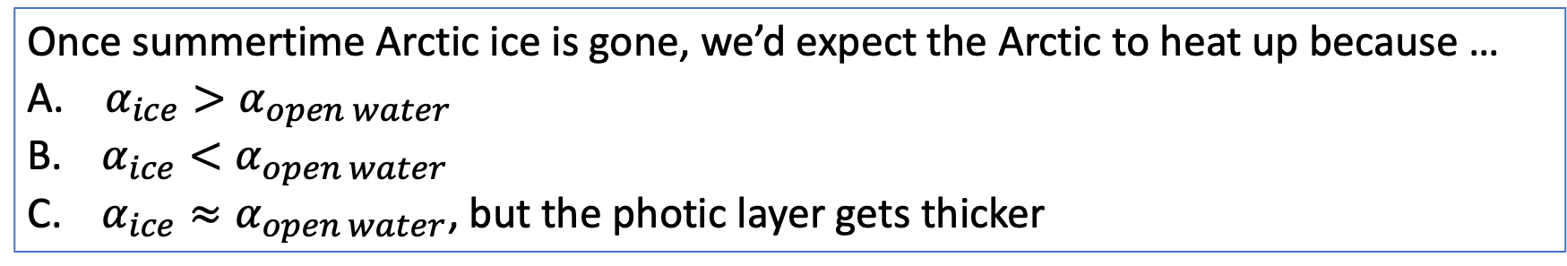
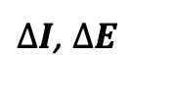
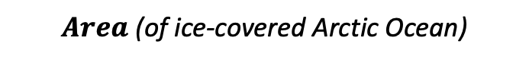
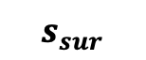
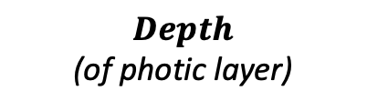

The kind of question I might ask
$$I$$
clouds
$$s_{sur}$$
$α$_{ocean}
$Area$ (of ice-covered Arctic Ocean)
$α$_{ice}
$∆I$, $∆E$
$Depth$
(of photic layer)
Once summertime Arctic ice is gone, we’d expect the Arctic to heat up because …
$α_{ice}>α_{open water}$
$α_{ice}<α_{open water}$
$α_{ice}≈α_{open water}$, but the photic layer gets thicker

